Slide 1
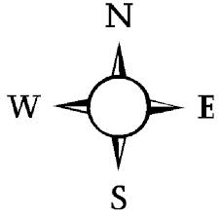
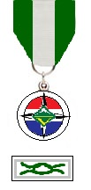


Discovery
Medal (compass and logo in silver)
Venturing
Pathfinder
Summit (but all in silver)
Knot

